Slide 1

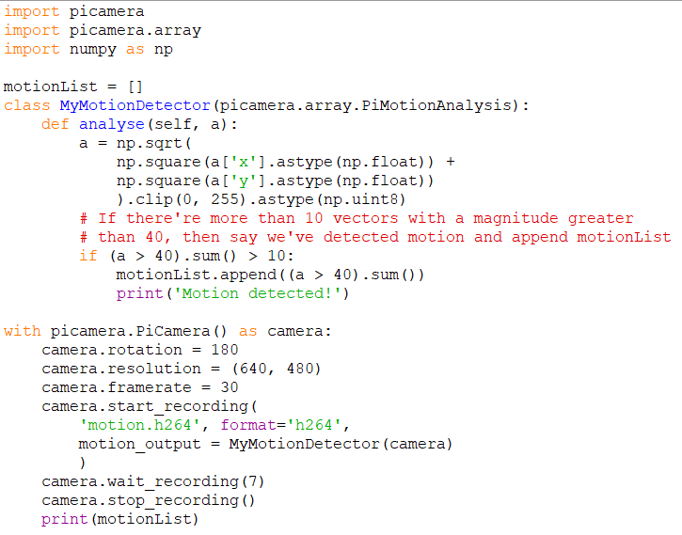
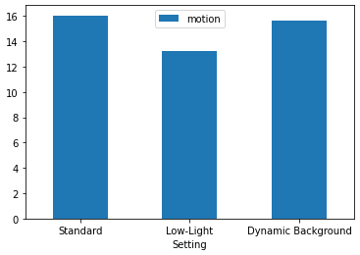
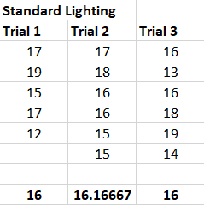
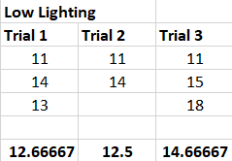
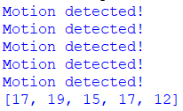
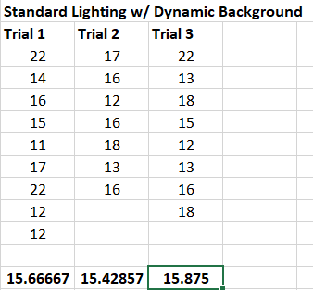
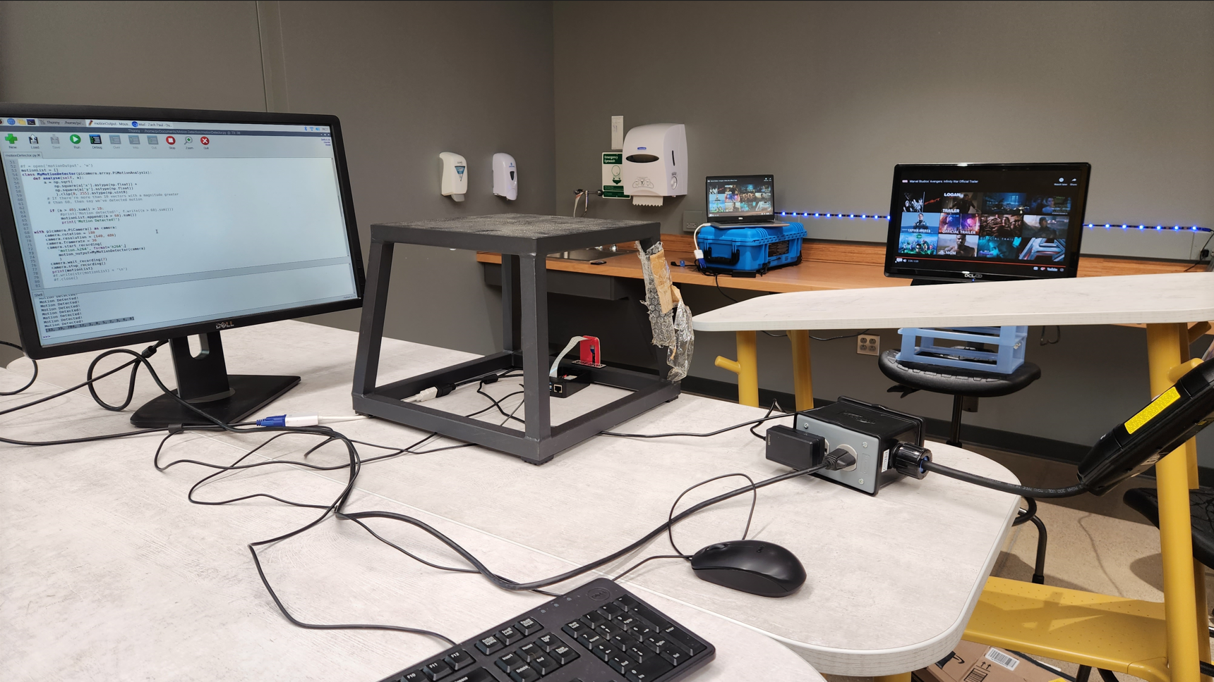
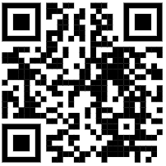
Effectiveness of PiCamera Motion Detection
Jim Collado, Kaleb Pierce, Zach Paul, Jack Hammer Project Mentor: Brian Krupp Department of Computer Science, Baldwin Wallace University Berea, Ohio 44017
Introduction
The goal of this project was to determine how effective the Raspberry Pi's picamera motion detection library is at detecting motion in different environments. To accomplish this, we created a crude motion detection program in Python, which uses the picamera library to capture a video and output a message any time motion that exceeds a given threshold is observed by the camera. In addition to outputting a message when motion is detected, the program also stores quantitative data about the detected motion for the purposes of analyzing the data to numerically determine how much motion was detected.
To measure the effectiveness of our motion detection system, we ran multiple tests in each of the environments of concern, which, as you'll learn more about later, consist of a standard lit environment, a low-lit environment, and a standard lit environment with a dynamic background. After quantifying the results from each, we then compare the results to determine how changing the environment has an impact on the overall motion detected
The Experiment
Results
Each of the tables below contain the motion data for each trial for each setting. The emboldened number at the bottom of each column is the average value for that column
Table 1. Table containing the motion data for each trial in an environment with standard lighting.
Overall Motion: 16.056
Figure 4. Bar graph representation of our results
Figure 2. Image the code for our motion detection program which was written in Python.
Our results indicate that the amount of motion detected in a low-lit environment was quite less than in standard lighting. The motion itself did not change, but the environment did, and the results indicate a difference in motion. Regarding a standard-lit environment with a dynamic background, the overall motion was only slightly less, a difference that is quite negligible. Overall, it appears that the effectiveness of the motion detection software was the same for both static and dynamic backgrounds, but was less effective in a low-lit environment
Shown above is the Python program written for our motion detection software. The program accomplishes various tasks that allow us to quantify our results that are used for later calculations. PiCamera motion data is represented by vectors, which is what we use to analyze motion. For our experiment, we are interested in the magnitude of said vectors. The program above calculates the magnitude of the vector for every instance of detected motion and stores it in the variable "a". To determine when significant motion is detected, we first want to check whether the magnitude of the present vector surpasses a certain threshold, which is 40 in this case. Then, we check if the number of vectors that have achieved this threshold surpass a threshold of 10, and if so, then the amount is stored in a list, and we output that motion was detected. At the end of the video, we have a list containing each significant sum. The output of the program above looks something like this:
To achieve standard lighting, we didn't have to change much. We simply recorded in the robotics lab with all the lights on
Materials and methods
Most of the work for our experiment was done on the Raspberry Pi, so the list of our materials wasn't very long. In addition to the Pi, we were given a no IR camera by Dr. Krupp. Our experiment took place in the Robotics Lab, where we were able to manipulate the environment per the demands of our different settings.
Since the purpose of our experiment was to compare motion in different environments without the actual motion itself changing, we wanted to replicate the type of motion for each video. Originally, we would have one of our group members walk in front of the camera for each video. However, being able to replicate the exact same speed and distance was quite difficult. Thus, we changed tactics.
Rather than walking, we decided to roll an object on an incline in front of the camera. By doing this, the object is a fixed distance from the camera, and the speed for each test is relatively the same given that gravity is the one doing the work here. All in all, this setup allowed for consistency between our tests.
Table 2. Table containing the motion data for each trial in an environment with low lighting.
Overall Motion:
13.278
Conclusion
Based on the results of our experiment, we can conclude that the effectiveness of the picamera motion detection can change with differing environments. If the camera is set in a low-lit environment, then it is unable to detect as much as motion when compared to a standard environment. If one were to use picamera motion detection software in, let's say, their home for detecting potential burglaries, then they would have to ensure the software can adapt to a darker environment. While a dynamic background seemed to have little to no effect on the motion detected, this result may change depending on the values set for the thresholds. Future work on this project may entail further experimentation with altering the thresholds and testing in environments not seen in this experiment. All in all, we can conclude a darker environment can alter the amount of motion detected.
With this setting, our goal was low light, not absence of light. To create this environment, we put down all the shades in the robotics lab with the lights off to allow just enough light for the camera to detect motion
Figure 3. Image of the output produced by our motion detection program.
Table 3. Table containing the motion data for each trial in an environment with standard lighting and a dynamic background.
To compare the motion data for each setting, we needed to have a single number represent the amount of motion for that setting. The process for obtaining this single value was as follows: For each video, we took the average of the sum list that was fully populated by the end of the video. The average represented the amount of motion for that video. For each setting, we ran three trials to account for any extraneous factors possibly affecting the data for a single video. Thus, each setting had three videos and three averages. We took the average of the averages for each setting, and the resulting number was the value used to represent the amount of motion for that setting. After running all trials and obtaining the value for each setting, we simply had to compare them for our results and conclusions.
Overall Motion:
15.657
Figure 1. Photo of our setup in the Robotics Labs, where we conducted our experiments.
To create a dynamic background, we placed a monitor behind the incline that was playing a movie trailer, and behind the monitor was a row of LED lights that would change color every second. The goal was to have active "motion" behind the primary motion to see if the secondary motion would affect our primary moving object.
PiCamera Documentation

